Slide 1
Clviz – Clarity analysis and visualization
Albert Lee, Jon Liu, Tony Sun, Luke Zhu
Email: alee156@jhu.edu

Slide 2
CLARITY
Large-scale brain visualization damaging structural integrity
Unprecedented connectivity estimates
Function estimation for whole brains

Slide 3
CLARITY analysis is underdeveloped
 | One Click | Scalability | Interactive
Clarity Tractograph Toolkit
Connectivity
ClarityViz
X
X
X
X
X
DiPy*
X
X
X
*designed for diffusion imaging, not CLARITY

Slide 4
3 click visualization pipeline
Open-source visualization and analysis pipeline which can be installed via PyPi
Packaged to run on any modern operating system (OSX, Windows, Linux)
Implemented as scalable cloud-computing web service

Slide 5
clviz pipeline

Slide 6
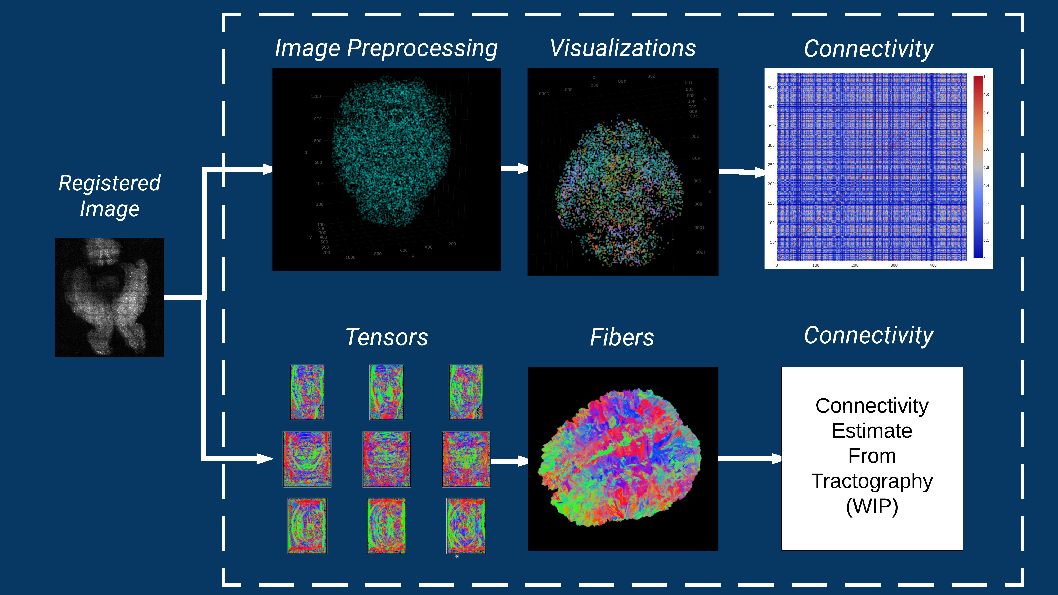

Slide 7
Image Preprocessing

Slide 8
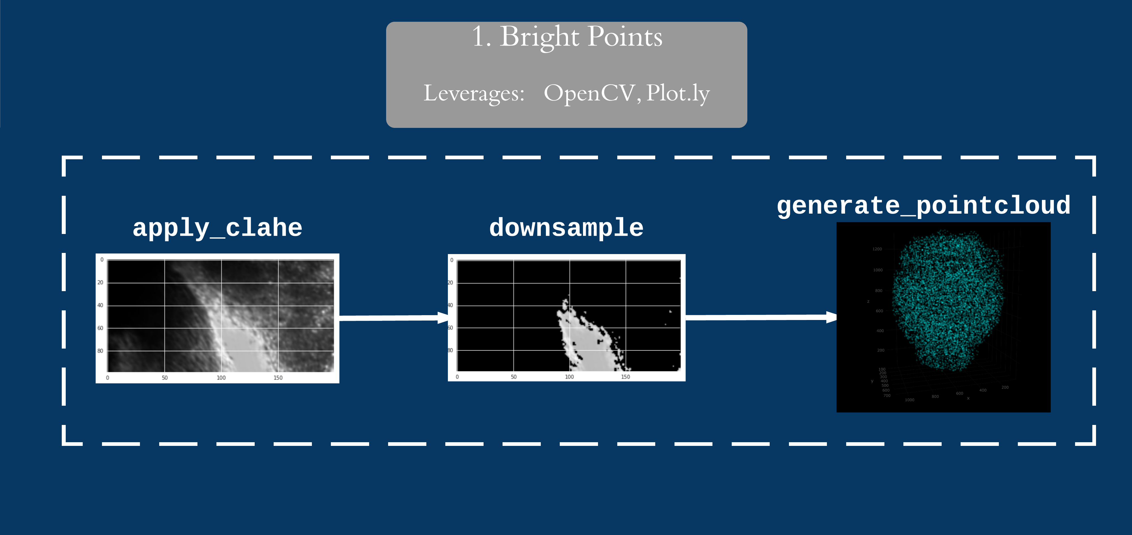

Slide 9
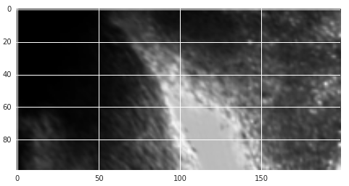
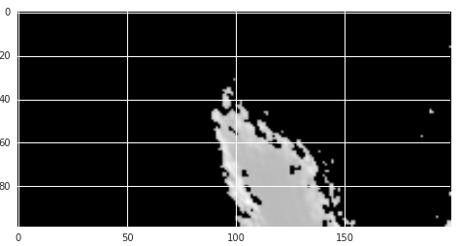
Find Locally Brightest Points in High Background Setting
CLAHE Docs
Subsample Docs
Raw Image
Post-CLAHE bright points

Slide 10
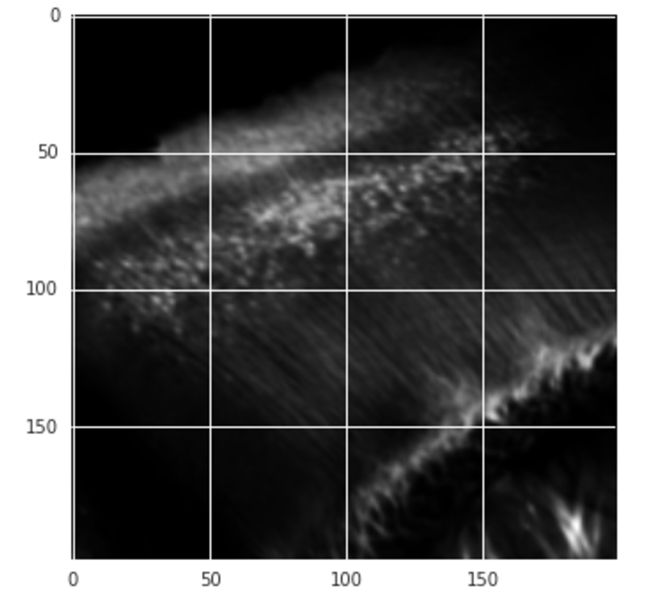
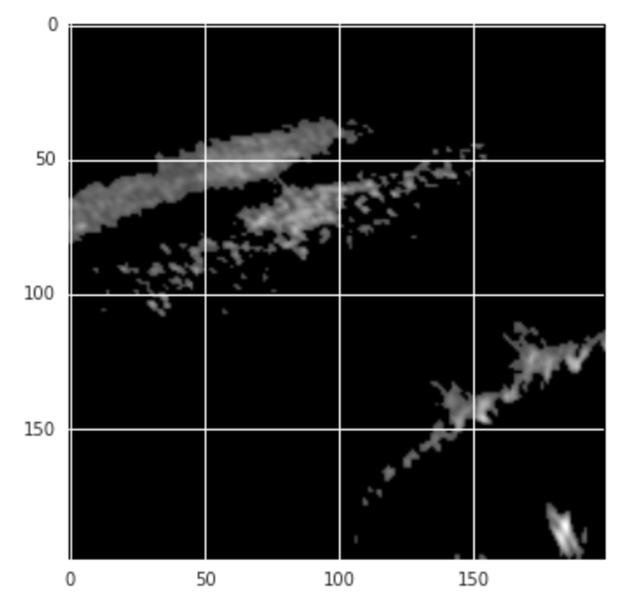
Find Locally Brightest Points in Low Background Setting
CLAHE Docs
Subsample Docs
Raw Image
Post-CLAHE bright points

Slide 11
CLARITY Visualizations:
Region Graph Epsilon-Ball Graph, Density Graph,

Slide 12
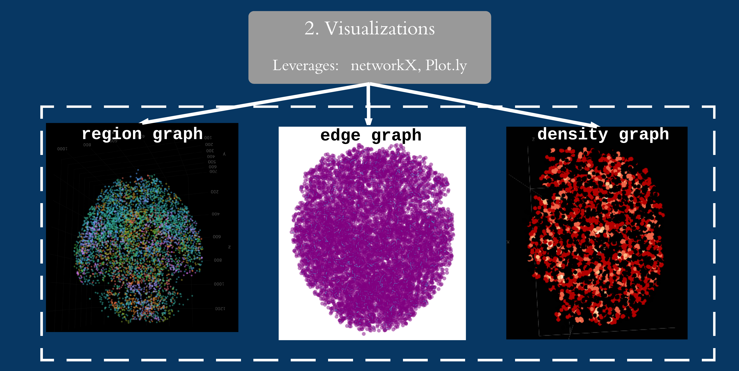

Slide 13
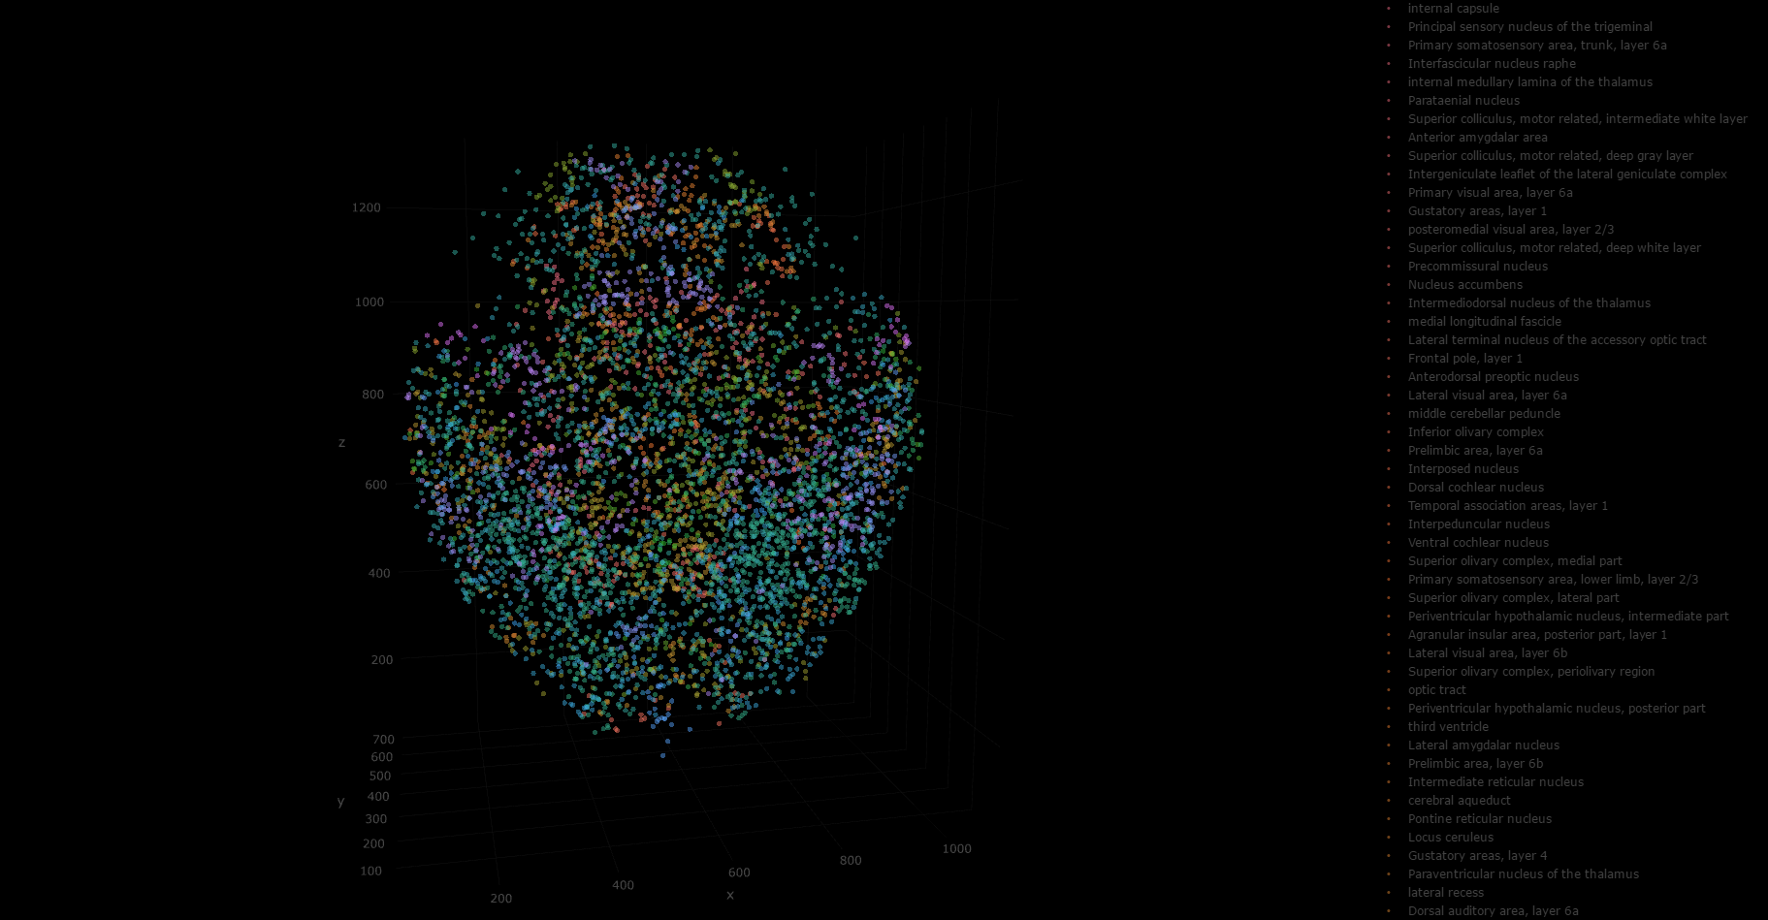
Interactive 3D Plot of Brightest Points with Atlas Regions (s3617)
Inputs: Atlas registered bright points
Outputs: Region graph
Each dot is one of 10,000 brightest points
Color is region, can interactively toggle regions
Mousing over dot provides region name and 3D coordinate (in ARA space)
Links to documentation:
Generating region CSV
Plotting region graph
Link to interactive plot in cloud

Slide 14

Notes:
LiveSlide Site
http://nbviewer.jupyter.org/github/NeuroDataDesign/seelviz/blob/gh-pages/Tony/html/april30/s3617_to_ara3_regions.html

Slide 15
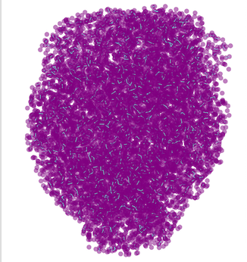
Interactive 3D Plot of Epsilon Ball Connected Graph (s3617)
Inputs: brightest points
Outputs: epsilon ball graph
Each point is one of 10,000 brightest points
Each bright point is a vertex
Edges determined by epsilon radii
Adjacency matrix useful later for connectivity
Links to documentation:
Generating graphML
Plotting edge graph
Link to interactive plot in cloud

Slide 16
Notes:
LiveSlide Site
http://nbviewer.jupyter.org/github/NeuroDataDesign/seelviz/blob/gh-pages/Tony/html/april30/s3617_to_ara3_edgegraph.html

Slide 17
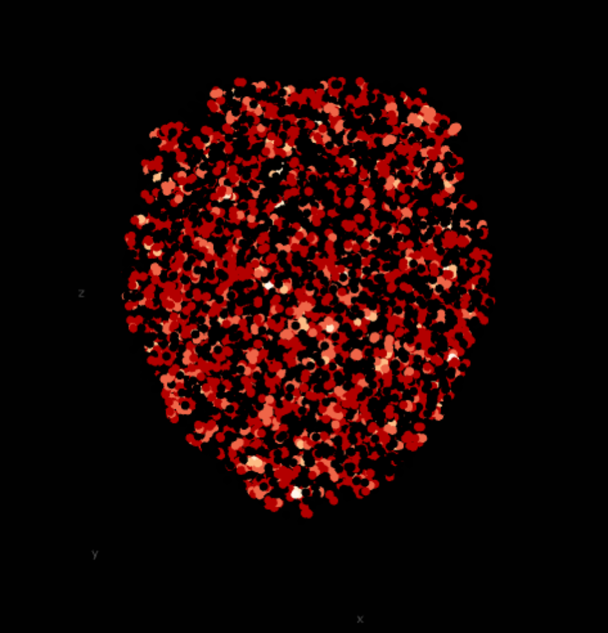
Interactive 3D Plot of Degrees Matrix (s3617)
Inputs: adjacency matrix
Outputs: degrees matrix
Each point is one of 10,000 brightest points
Density graph shows the relative activity of given areas (brighter areas are more active)
Colored by the number of edges (interactive heatmap)
Link to documentation
Link to interactive plot in cloud

Slide 18
Notes:
LiveSlide Site
http://nbviewer.jupyter.org/github/NeuroDataDesign/seelviz/blob/gh-pages/Tony/html/april30/s3617_to_ara3_density.html

Slide 19
Connectivity Estimation

Slide 20
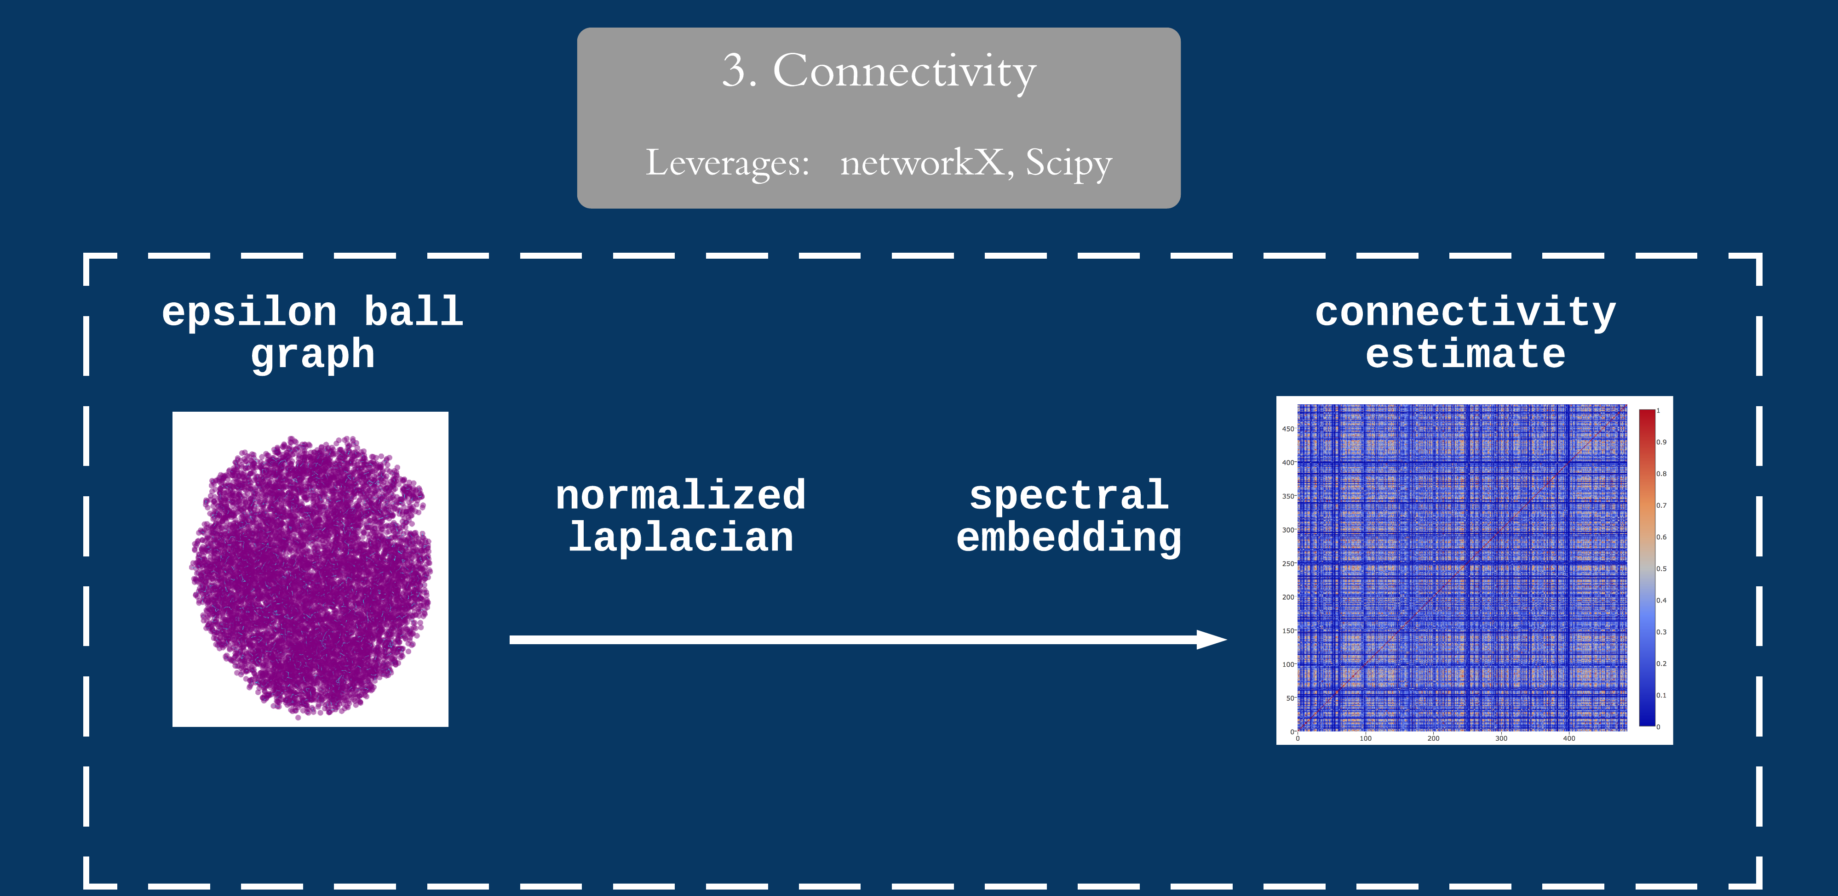

Slide 21
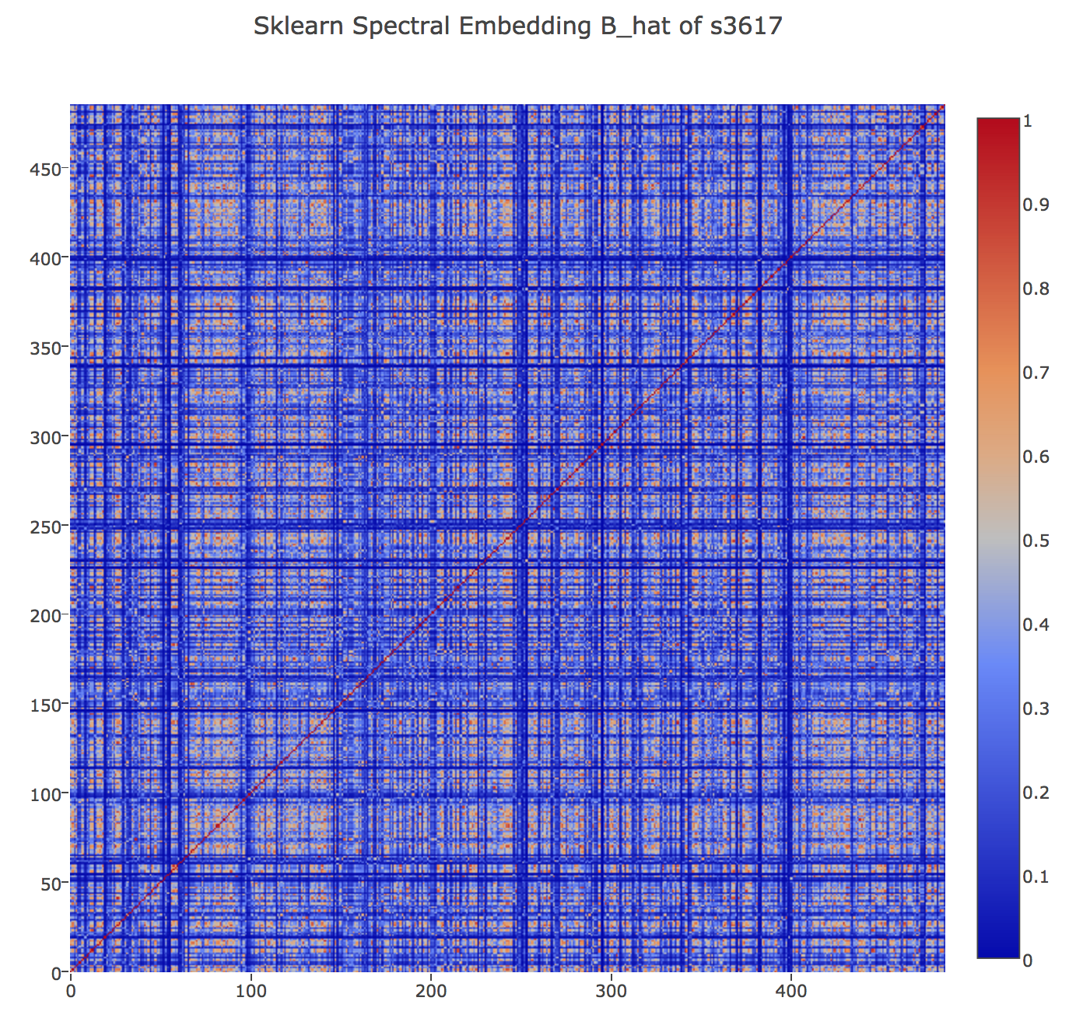
Connectivity Estimates (s3617)
Inputs: Epsilon ball graph
Outputs: Inter-region connectivity
Similarity matrix showing estimated connectivity between given brain regions
Generated by calculating spectrally-embedded results from graphML and epsilon ball graphs
Link to documentation
Link to interactive plot
Link to spectral embedding in 3D

Slide 22
Notes:
LiveSlide Site
https://nbviewer.jupyter.org/github/NeuroDataDesign/seelviz/blob/gh-pages/Luke/s3617_SE_connectivity.html

Slide 23
Tensors and Fibers

Slide 24
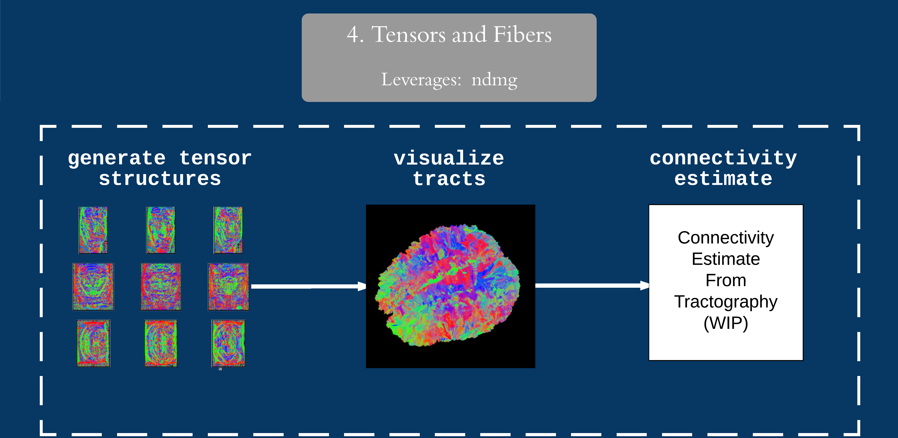
Docs

Slide 25
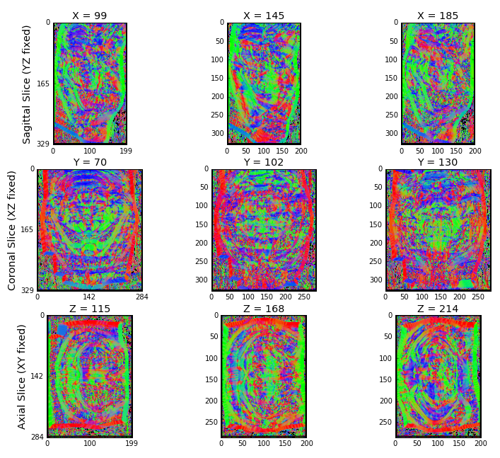
Structure tensor generation (CTT data set)
Inputs: Raw image
Outputs: Structure tensor
Generates FSL and DTK structure tensors from TIFF stacks of raw image data.
Saves QA figures such as FA maps for perusal.
Links to documentation:
Structure tensor code
FA map generation

Slide 26
One-Click Deployment of clviz
Submit batch job:
python create_job.py --bucket clviz-bucket --credentials accessKeys.csv --token s3617_to_ara3
Launch web service:
docker run -it -p <local_port>:8070 --name web jliu118/clarityweb:run

Slide 27
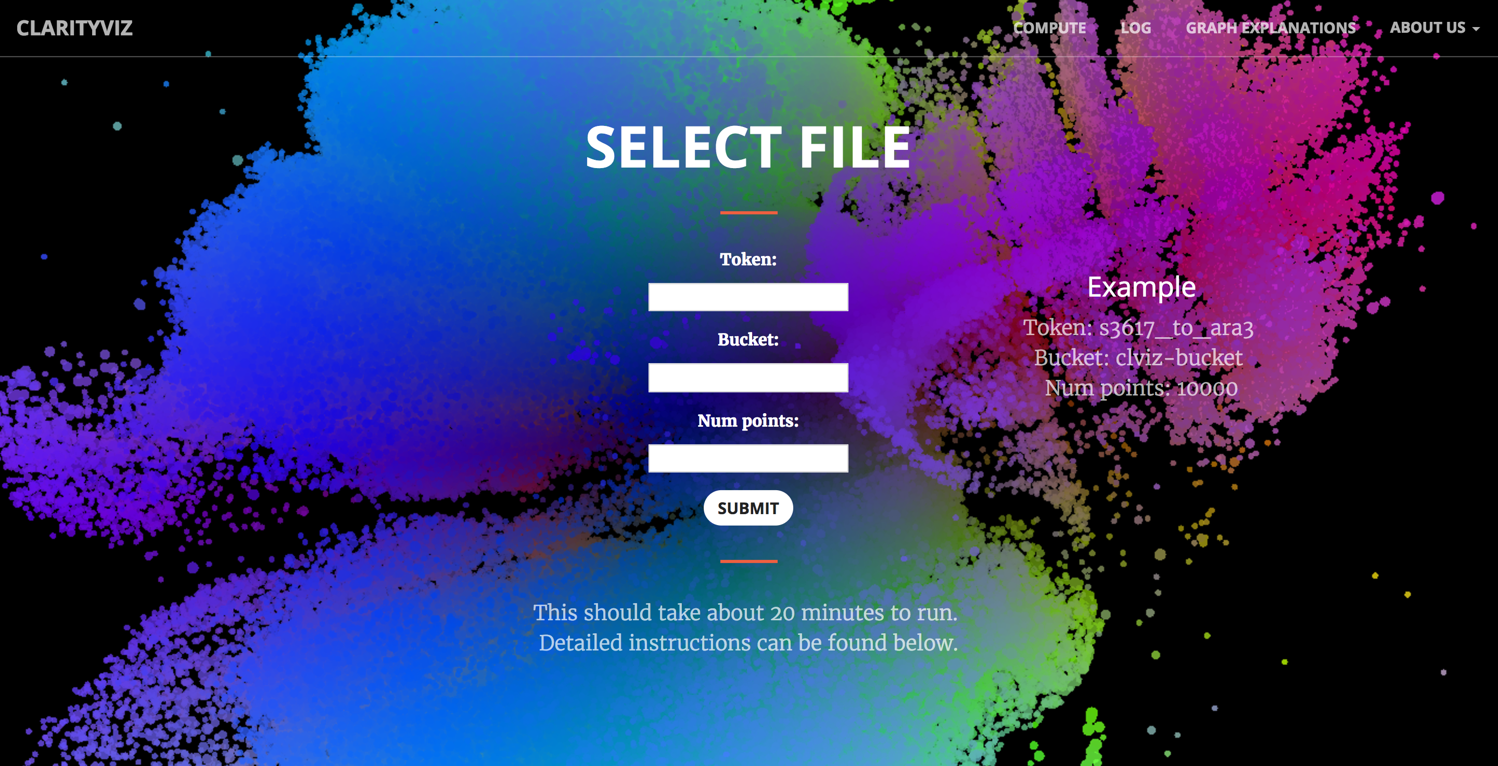
Live Web Service

Slide 28
Demo (and Questions)

